Slide 1

CryptoPunks Visualization Enhancement
Project 2:
Avery Vann
Jerren Fair
Randall Crawford
Project 2:
Brian Smith
Dustin elery
Place hold

Slide 2
Agenda
1. Theme
2. Coding Approach
3. Data Munging
4. Final Visualization

Slide 3
Theme
Our group is interested in current technology trends, specifically NFTs, which stands for non-fungible tokens. With NFTs being a relatively new trend, we narrowed our focus to a popular collectible NFT that has been around for a few years and has an established market, CryptoPunks.
CryptoPunks are a collectible digital image that is popular on internet forums and trading. You can find the primary site here: https://www.larvalabs.com/cryptopunks
Our website allows the user to type a CryptoPunk ID into a search menu, then displays the image attributes of the CryptoPunk along with sales trends over time for the selected CryptoPunk.
The target audience for our website would be those individuals who are interested in purchasing CryptoPunks and want to visually see the data represented in an easy to read format using data visualization tools. Right now on the LarvaLabs website, the data is listed in list format, and gets cluttered with bids & offers, while we are only interested in sales data.

Slide 4
Coding Approach: Back End
Two separate Git Repositories: Back and Front End
Back End:
1. In our first file we do the following:
Using Python Pandas, we pull in a .txt file from http://subopt.org/priceseth.txt to get our CryptoPunk market data (the trade details for each Punk)
This website is already doing the screen scraping daily
Using Python Pandas, we pull in a .csv file from taken from https://github.com/cryptopunksnotdead/punks to get the Punk image attributes
We then push this data to a PostgreSQL database
2. In our app.py file we use a flask operation to route our data to several “/” paths for consumption
The primary API pull comes from our “…/punk/{entered id}
In this app we serve the market and attribute data as lists of dictionaries

Slide 5
Coding Approach: Front End
Front End:
1. In our Javascript file:
We create a function to create a table of the Punk attributes using the new JS Library “Tabulator”
http://tabulator.info/
We then plot the table of market data found on the Punks website into Plotly chart to show the trading trends over time
2. Our index.html file takes the standard approach of calling in the appropriate files for rendering the CSS and .js file
3. Front End Precursor: Instead of bringing all data into the front end, we query the required data from the user menu input and return only the data needed

Slide 6
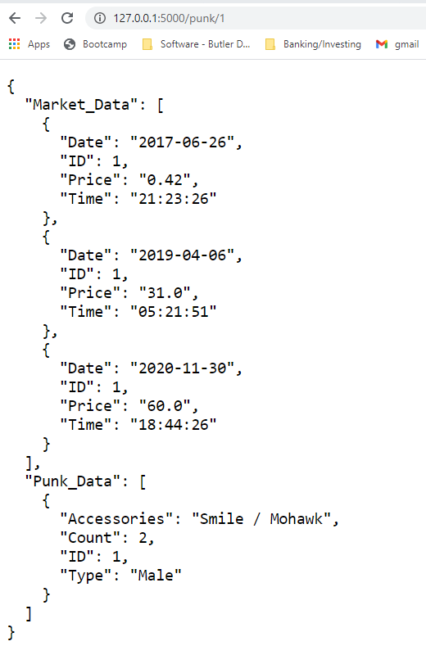
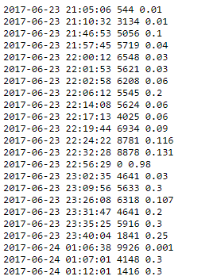
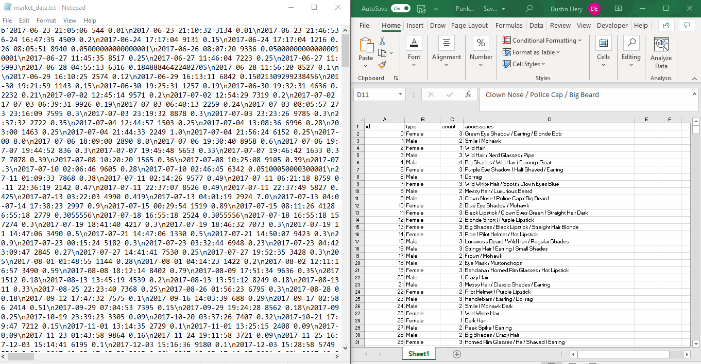
Data Munging
1. In our back-end files we are parsing and using replace functions to make the Date variables render as a date appropriately in our Postgres instance
2. We then used python flask operations to render out data as lists of dictionaries for our front-end consumption
Original Files:
Final Data for Consumption:

Slide 7
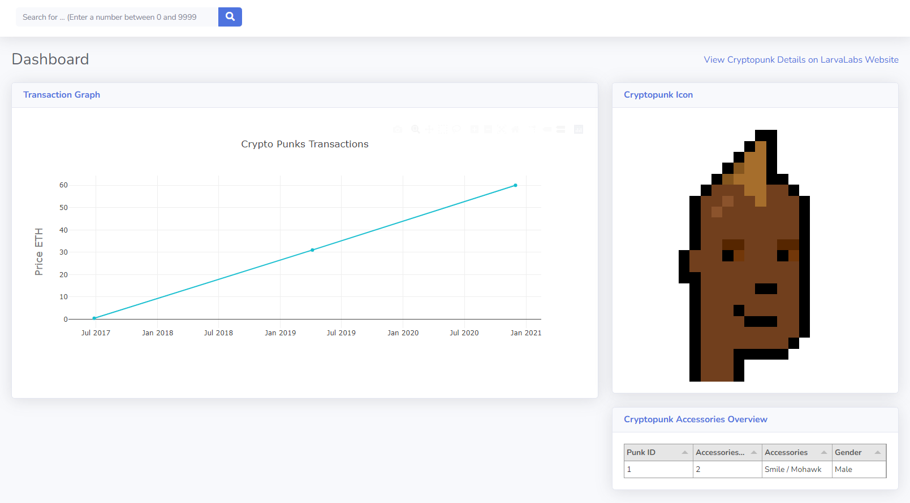
Final Application: Dashboard
Using the user entered CryptoPunk ID, the app dynamically shows: an image from the CryptoPunks site, table of attributes, and historical market data (if available, not all punks have market transactions)

